Slide 1

Information Security
Examples and Impacts of CIA
Week 1

Slide 2
Examples of applications illustrating security breach impacts, categorized into three levels based on FIPS PUB 199:
Low Impact: Minimal adverse effects, such as slight mission capability reduction, minor asset damage, small financial loss, or minor harm to individuals.
Moderate Impact: Serious adverse effects, including significant mission degradation, notable asset damage, considerable financial loss, or significant harm (but not life-threatening).
High Impact: Severe consequences, such as complete mission failure, major asset damage, substantial financial loss, or life-threatening harm.

Slide 3
Security Aspects of Information Assets
Confidentiality:
High: Student grade information is highly confidential and protected by FERPA (Family Educational Rights and Privacy Act). Only students, parents, and authorized staff can access it.
Moderate: Student enrollment data is moderately confidential, seen by more people but still protected by FERPA.
Low: Directory information (student/faculty lists) is publicly available and often posted online.
Notes:
Family Educational Rights and Privacy Act.

Slide 4
Integrity:
High: Hospital patient allergy records must be accurate to prevent harm or legal issues. Any falsification must be traceable and quickly corrected.
Moderate: Online forums may suffer from fake posts or defacement, but the impact is limited to user experience and minor financial loss.
Low: Anonymous online polls are often manipulated but are not meant for serious decision-making.

Slide 5
Availability:
High: Authentication systems for critical services must always be available, as downtime leads to major financial and productivity losses.
Moderate: A university’s public website, while important, is not critical, though downtime may cause inconvenience.
Low: An online phone directory is useful but not essential, as alternative sources exist.

Slide 6
Challenges of Computer Security
Complexity: Security requirements are straightforward (e.g., confidentiality, integrity), but the mechanisms are complex and require subtle reasoning.
Unpredictable Attacks: Attackers often exploit unexpected weaknesses in security mechanisms.
Counterintuitive Measures: Security mechanisms can seem excessive until threats are fully understood.
Placement Decisions: Determining where and at what layers (e.g., TCP/IP) to implement security is critical.

Slide 7
Key Management: Security depends on secret information (e.g., encryption keys) and reliable communication protocols.
Battle of Wits: Attackers need only one weakness, while defenders must eliminate all vulnerabilities.
Perceived Value: Security investments are often undervalued until a breach occurs.

Slide 8
Constant Monitoring: Regular monitoring is challenging in fast-paced environments.
Afterthought: Security is often added after system design, not integrated from the start.
Efficiency vs. Security: Strong security is sometimes seen as a barrier to usability and efficiency.

Slide 9
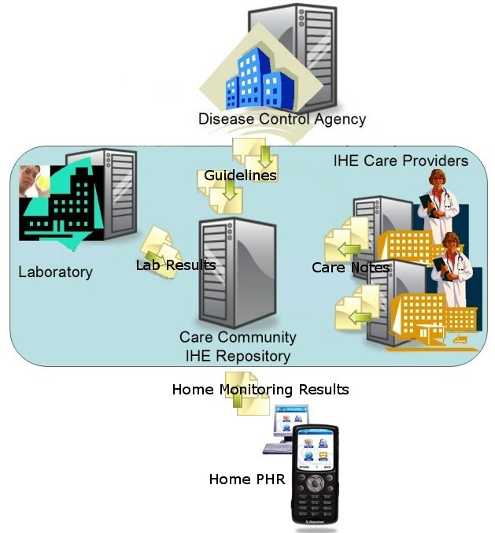
Infomation system
Components
Hardware
Networks
Software
Data
Procedures
Policies
Personnel

Slide 10
Information Security
The concept of computer security has been replaced by the concept of information security
Covers a broad range of issues
From protection of data to protection of human resources
Information security is no longer the sole responsibility of a discrete group of people in the company
It is the responsibility of every employee, especially managers

Slide 11
Information Security Communities
InfoSec community
  Protects the organization’s information assets from the threats they face.
IT community
  Supports the business objectives of the organization by
  supplying and supporting information technology
  appropriate to the business needs
Non-technical general business community
  Articulates and communicates organizational policy and objectives and allocates resources to the other group

Slide 12
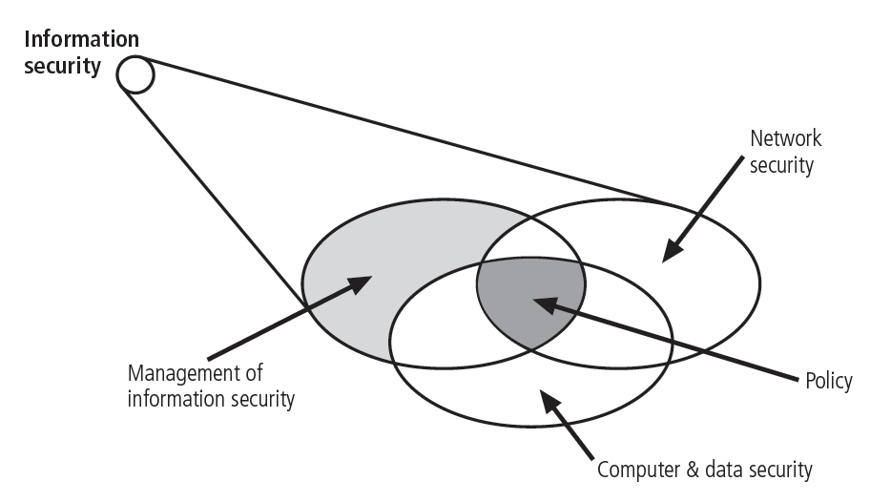
CNSS Security Model

Slide 13
A more general security model
CNSS Security Model
  Also known as the McCumber Cube
  Provides a more detailed perspective on security
  Covers the three dimensions of information security

Slide 14
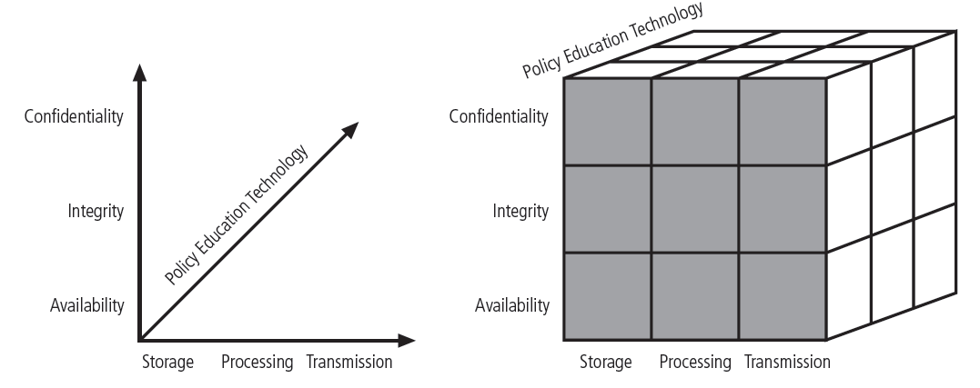
CNSS Security Model (cont)

Slide 15
What is the CNSS Security Model?
A framework developed by the Committee on National Security Systems (CNSS)
- Focuses on protecting national security systems and sensitive information
- Used by government, military, and private organizations handling classified or critical data
Currently using by US Government

Slide 16
The CIA Triad – Foundation of CNSS
Three Core Principles:
- Confidentiality: Ensures only authorized users can access data
- Integrity: Protects data from being altered or tampered with
- Availability: Ensures data and systems remain operational and accessible

Slide 17
Policy Education in Technology..CNSS
Educates users on security policies and regulations for technology use.
Ensures compliance with legal and organizational security standards.
Helps organizations understand risk management and cybersecurity best practices.
Promotes awareness about ethical and responsible technology use in national security settings.

Slide 18
Purpose of the Model
.
- Establishes security guidelines and best practices
- Ensures information security through risk management and compliance
- Helps organizations defend against cyber threats and unauthorized access

Slide 19
structured approach
A structured approach refers to a systematic, organized, and well-defined method of handling security measures within an organization. In the context of the CNSS Security Model.
this means:
1. Defined Security Principles – The model follows the CIA Triad (Confidentiality, Integrity, and Availability) as the foundation of security.
2. Standardized Procedures – Organizations must implement security best practices, risk management, and compliance measures consistently.

Slide 20
conti
3. Layered Security Measures – A combination of technical, administrative, and physical controls ensures robust protection.
4. Continuous Monitoring & Improvement – Security is an ongoing process involving assessments, audits, and proactive responses to emerging threats.

Slide 21
Conclusion & Final Thoughts
- The CNSS Security Model provides a structured approach to protecting national security systems
- It ensures confidentiality, integrity, and availability of critical data
- Organizations must adopt best practices and risk management strategies to stay secure

Slide 22
Questions?

